Slide 1
Progress Seminar
Team 10
Mohamed Regaieg
12/4/2017

Slide 2

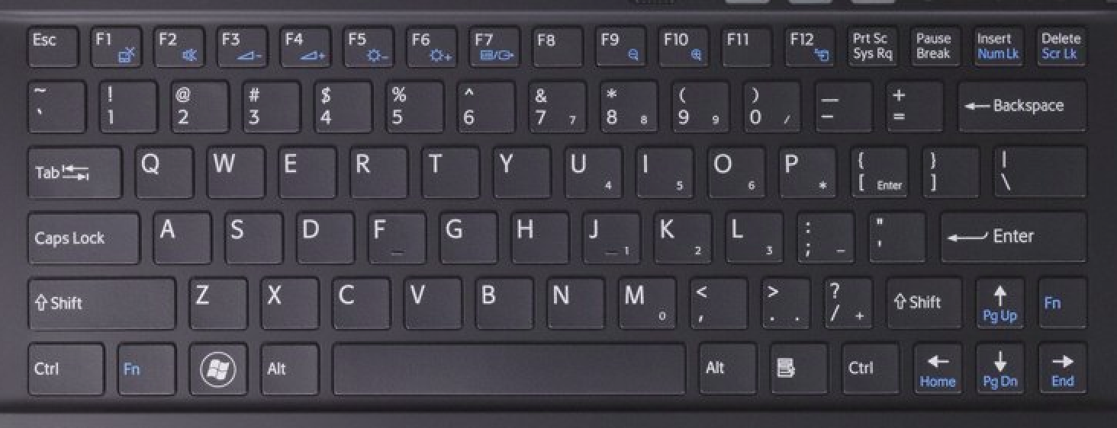
Driver Interface
Use of the keyboard to control the recovery system.
Implementation of a first version.

Slide 3
Driver Interface
Available resources:
  send_str(char msg[]);
  char get_char(void);
  Keyboard
  Terminal (Standard text editor)
Limitation resources:
  Only one key button can pressed at each moment

Slide 4
Driver Interface
Keyboard map:
Key | Function | Key | Function
q/a | Winch step up/down | y/h/n | Three different speeds
z/x | Turn camera one step left/right | i/m | Move the car forwards/backwards
1/2 | Turn light on/off | k | Stop the car
r/f | Raise/lower upper claw | j/l | Turn car left/right
t/g | Raise/lower lower claw | J/L | Spinning the car to the left/right

Slide 5
Driver Interface
Feedback to the driver: after any change the system status will be printed in the terminal:
  Positions of the servo
  Duty cycle and direction of each DC motor
  Light state
  Integration of stepper movement for the next version

Slide 6
Driver Interface
Upcoming tasks
  Validation with the whole system
  Adjusting the control speed of the car
  Adjusting the stepwise movement of the servos and the stepper
  Improving the feedback

Slide 7
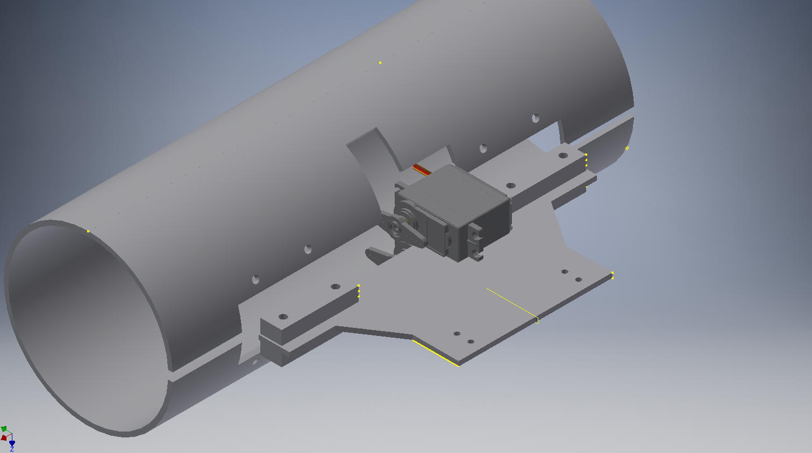
Claw Design

Slide 8
Claw Design
Needed parts:
  1 Pipe
  2 pipe caps
  4 hinges
  2 servo motors
  1 aluminium plate sheet
  4 M4 x 25mm bolts and their nuts
  6 M3 x 15 bolts and their nuts

Slide 9
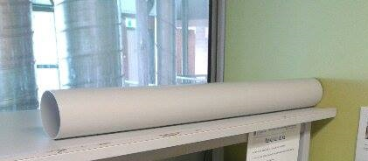
Claw Design
The PVC pipe: DN100 SN6
  Inner diameter 104 mm
  Large enough:
    larger than the widest section of the submarine (72 mm)
    Submarine can be inclined (approximately 100 mm are needed)
  Used length 300 mm, split into
    One quarter: lower claw part
    3 quarters: upper claw part.

Slide 10
Claw Design
Servo motors
  Torque calculation: assumptions
    One rock is grabbed with the submarine
    Servo pipe connection at 1 cm from the servo axis
    The whole load is acting at the furthest point
      100 mm for the upper claw part
      50 mm for the lower claw part
    System underwater (Buoyancy against gravity)
    Considered loads:
      Pipe + caps
      Submarine
      Rock

Slide 11

Claw Design
Servo motors
  Torque calculation: results:
    Upper claw: 2.5 Kgcm
    Lower claw: 5 Kgcm
  Selected motor MG995
    Torque is large enough for this application (13-15 kgcm)
    Used by wide community
    Very cheap ($5)

Slide 12
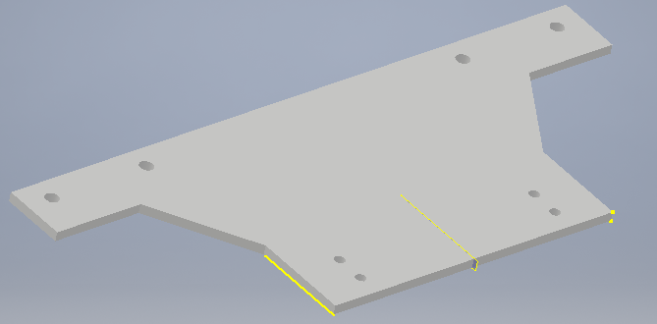
Claw Design
Aluminium plate
  Torque calculation
    Assumptions:
      Plate is rectangular with 3 mm thickness
      Holes are neglected
      System underwater (Buoyancy against gravity)
    Results
      Maximum stress = 3 MPa = 0.03 yield stress
      Strain = 4 10^-5

Slide 13
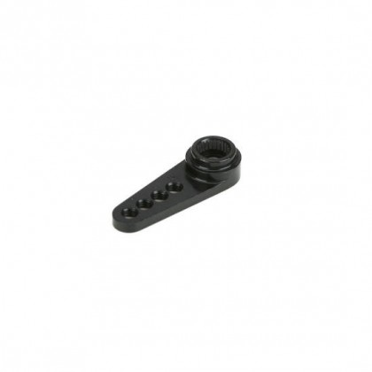
Claw Design
Motor pipe attachment:
  Position the motor arm between two aluminium pieces attached to the pipe
  Still need torque calculation
  Alternative
    One aluminium parts attached the servo arm (Bolts M1.6)
    two aluminium pieces attached to the pipe

Slide 14
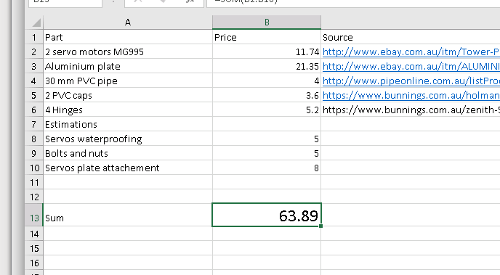
Claw Design
Cost estimation

Slide 15
Claw Design
Further calculations
  Weight of the whole claw : 1.3 Kg
  Buancy of the whole claw: 6.13 N

Slide 16
Claw Design
Upcoming tasks
  Waiting for the aluminium parts from Doug (The waiting list seems to be extremely long)
  Cutting the pipe at the STC
  Waiting for the motors (they should be here at most by the end of next week)
  Connect the servo to the plate ($8 are available for that)
  Buy the caps, cut them and attach them to the claw
  Waterproofing the servos ($5 Graisse and Plasti Dip)

